Slide 1
EMPLOYEE DATA ANALYSIS USING EXCEL
NAME : R.RAMYA
REGISTER NO. : 312215062
DEPARTMENT: COMMERCE ( BCOM)
COLLEGE : SOKA IKEDA COLLEGE OF ARTS AND SCIENCE FOR WOMEN

Slide 2
PROJECT TITLE
EMPLOYEE PERFORMANCE ANALYSIS USING EXCEL

Slide 3
AGENDA 1. Problem statement 2. Project overview 3.End users 4.Our solution and proposition 5. Dataset Description 6.Modelling approach 7.Results and discussion 8.Conclusion

Slide 4
PROBLEM STATEMENT
1.How can we develop an effective training program to enhance employee skills and knowledge, leading to better job performance?
2. What are the root causes of high employee turnover, and what strategies can we implement to retain top talent?

Slide 5
PROJECT OVERVIEW
TO ANALYSE AND EVALUATE EMPLOYEE PERFORMANCE IDENTIFY AREAS OF STRENGTH AND IMPROVEMENT AND PROVIDE INSIGHTS FOR INFORMED DECISION MAKING

Slide 6
WHO ARE THE END USERS?
ORGANISATION

Slide 7
OUR SOLUTION AND ITS VALUE PROPOSITION
=IFS(Z8<=5"VERY HIGH ",Z8<=4,"' High",Z8<=3,"Med",True,"low")- calculate employee performance
Pivot table -summary
Graph - data visualisation
Conditional formatting - finding blanks
Filters - removing missing values

Slide 8
Dataset description
1.Employee data set = kaggle.com
2. Employee ID- numericals
3. Name- text form
4. Business unit
5. Gender code
6. Performance score
7. Current employee rating
8. Performance category

Slide 9
The "WOW" in your solution
Performance category
= IFS(Z8<=5,"very high",Z8>=4"high",Z8>=3,"Med",True,"Low")

Slide 10
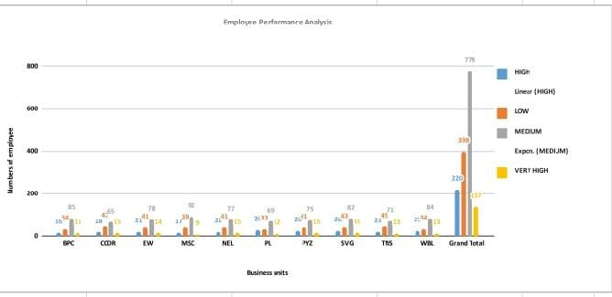
Results

Slide 11
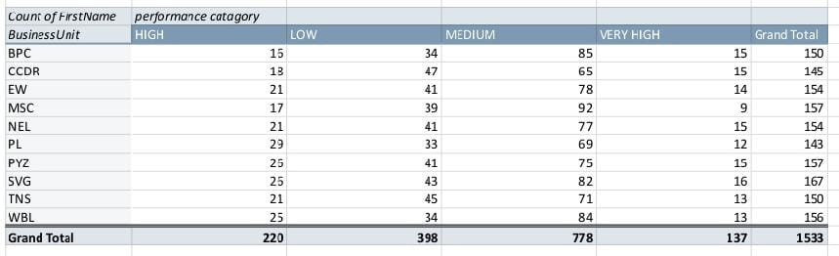

Slide 12
Conclusion
Target encouragement and motivation medium level performing employee can be developed into high performing employees leading to a gradual increasing overall performance trends.By recognising and buliding on their strengths, providing Tailored support and resource and fostering have growth oriented culture, organisation can unlock the full potential of dark work force and dry sustained improvement in performance outcomes.

Slide 13
THANK YOU

